Slide 1
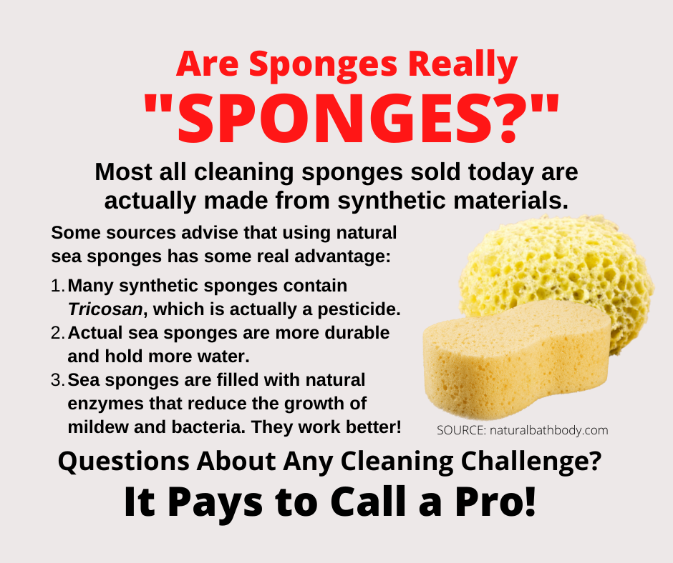
6 Items Many Neglect to Replace
Do you have the tendency to collect items, never letting them go? Or maybe you tend to get as much use out of items as you can, keeping them longer than perhaps recommended, before replacing them?
No one wants to be wasteful, yet there are many items you use that should be replaced on a regular basis, on a schedule. While there could be dozens of items like this, today we will concentrate on just six everyday items that need to be regularly replenished, for a variety of reasons.
Sponges. Sponges are great tools we use for cleaning surfaces, and some of those surfaces can be quite germy. While the appearance of your sponge may be acceptable, you should replace it every 3-4 weeks.
Toothbrushes. Advice for changing your toothbrush comes from a solid source. According to the Centers for Disease Control and Prevention (CDC), replace your toothbrush every three to four months. If you use a battery powered toothbrush, you should change the bristles on a similar basis.
Toilet brush. You use these to clean toilets. Enough said. Change them every six months, or even more often in a busy household.
Water filters. Filters that supply your drinking water can be found attached to your water spigots, and in your refrigerator, among other uses. Most manufacturers recommend replacing filters every six months. While some can taste the change in water when a filter is dirty and not effective, don’t base frequency on this. Follow a schedule.
Pillows. Pillows are meant to be comfortable and usually used just by you, but they are also a reservoir of dead skin, hair, and other potential contaminants. Replace them every one to two years, even if you really love your pillow.
Fire extinguishers. This is a no-joke type of monitoring and replacement because a fire extinguisher is meant to save your life. It is recommended to change them every 12 years, and recharge them halfway through their life. Keep an eye on the pressure, making sure it isn’t losing strength as it sits unused, which is how you want fire extinguishers to exist. Never used.
Replacing items that can go bad, or have expired, is an act of cleaning, tidying things up, keeping your home in optimal operating condition. And when it comes to cleaning, you can get excellent advice from your favorite cleaning company. After all, it pays to call a pro!
Short & Simple • © 2021 Thinkshortcut Publishing, LLC • Created by MarketingZoo.com

Slide 2
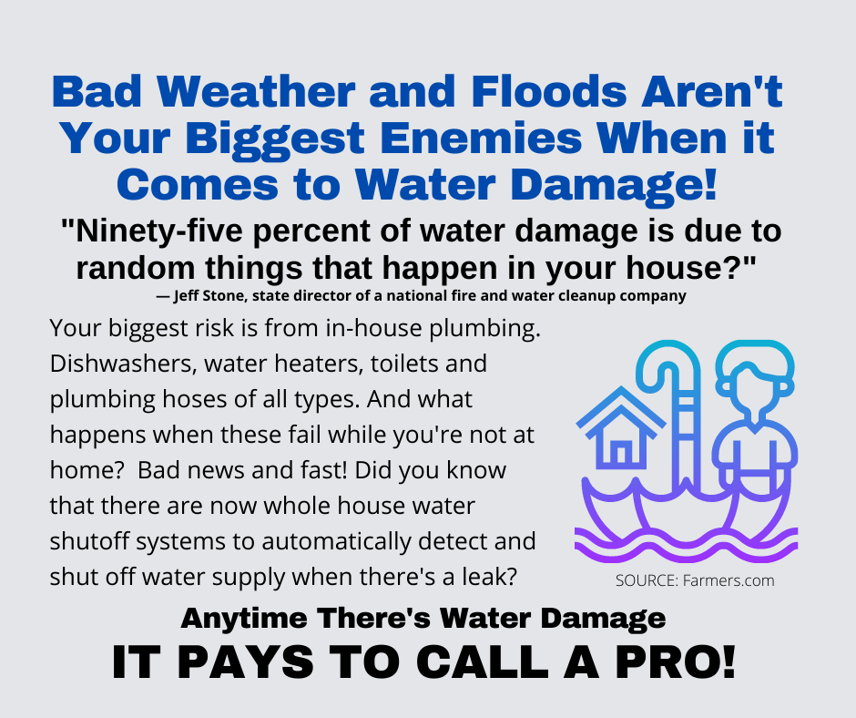
How to Shut Off Your Water in an Emergency
There’s nothing that can get a person to move faster than to have a pipe break in a home, with water spraying everywhere, soaking everything, and ruining furnishings, flooring, documents, and more.
The “moving faster” part of this unwanted exercise is often the frenzy with trying to find and turn off the water source, the main water feed into the home, and that location is usually not top-of-mind until the moment it is urgently needed.
Turning a valve off and saving your home is a simple concept, but if you don’t know where to find that valve, extensive damage will occur.
With most properties in warm climates, the main valves are often outside, easy to access. But in colder climates, those valves are inside, either in a basement if the home has one, or in a utility area, out of the way. And often, none of them are marked.
In addition to the typical shut-off valves, most homes have a main valve in the yard, an underground area with a cover that can be removed and give you access to it. Sometimes a special tool is needed to operate the valve.
But if you own a typical home with a basement, you have an advantage. The main shut-off valve is most often found near the front, on or near the wall closest to the street, where the water feeds into the home. If you have a private well, it should be on the side of the well, on that wall. If the valve isn’t on that type of wall, it may be near the furnace or water heater.
If you have a crawlspace, you may have a disadvantage. The valve may be in there, in that tight space that is usually full of cobwebs and dirt. You might have to go in there to reach the valve. But make sure it is in there; do that right now, so you aren’t trying to reach a valve that turns out isn’t in there at all.
When you do find the valve, you have to turn it. Turn clockwise, like when putting a screw into a board or a lid onto a jar. The valve may be rusty, difficult to turn. Lack of use makes the task more difficult. You can use a wrench to do it but be careful not to break the handle of the valve.
If, or more precisely, when a pipe breaks and you have resulting water damage, do the right thing. Contact your favorite disaster restoration company. After all, it pays to call a pro!
Short & Simple • © 2022 Thinkshortcut Publishing, LLC • Created by MarketingZoo.com

